Slide 1
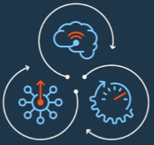
Meghódítani az ismeretlent Érzékeld és cselekedj
IBM #QRadar
Csendes Balázs
Security Operations & Response Leader, CEE
May 20, 2017
Notes:
The cognitive era is here. Digital everything means that technology’s number one job in business now is handling and responding to data. But this isn’t a story about big data’s takeover. This is a story about how cognitive capabilities are being applied to security to establish a relationship between machines and humans and how the role of technology can now change from enabler to advisor. We are ushering in this new era of cognitive security to outhink and outpace threats with security that understands, reasons and learns.

Slide 2
Napjaink biztonsági kihívásai
MEGFELELÉSEK
FELKÉSZÜ-
LETLENSÉG
FEJLETT
TÁMADÁSOK
EMBERI
HIBÁK
INNOVÁCIÓ
Notes:
Today’s security drivers:
Compliance – adapting to a threat-aware, risk based approach vs. compliance based, box checking approach. In August 2015 a federal court ruled that the Federal Trade Commission (FTC) has the authority to take action against organizations that fail to protect consumer information against cyber attacks. The court’s ruling should lead to greater scrutiny of corporate cyber security following a breach of personal privileged information.
Source: http://www.pcworld.com/article/2974771/appeals-court-denies-challenge-to-ftcs-cybersecurity-enforcement.html
The Federal Communications Commission (FCC) reached a $25 million settlement with AT&T Services over allegations the phone carrier failed to protect the personal data of hundreds of thousands of customers whose personal information was compromised in a data breach that occurred between November 2013 and April 2014. Source: http://topclassactions.com/lawsuit-settlements/lawsuit-news/53582-att-to-pay-25m-in-data-breach-settlement-with-fcc/
Human error – More than half of data breaches are caused by insiders, including employees, third-party contractors and partners. Source: http://www-03.ibm.com/security/data-breach/2015-cyber-security-index.html?ce=ISM0484&ct=SWG&cmp=IBMSocial&cm=h&cr=Security&ccy=US
Skills gap - experts predict a shortage of 1.5 million open and unfilled security positions by 2020. Source: Frost & Sullivan Report, 2015
More than 209,000 cybersecurity jobs in the U.S. are unfilled, and postings are up 74% over the past five years, according to a 2015 analysis of numbers from the Bureau of Labor Statistics by Peninsula Press, a project of the Stanford University Journalism Program.
Source: http://www.forbes.com/sites/stevemorgan/2016/01/02/one-million-cybersecurity-job-openings-in-2016/#683b25157d27
Innovations – cloud, mobile, IOT create unprecedented risks to organizations. 44% of security leaders expect a major cloud provider to suffer a significant security breach in the future. 33% of organizations don’t even test their mobile apps. CISCO estimates that by 2020, there’ll be 50 billion devices connected.
Sources: https://www-03.ibm.com/press/us/en/pressrelease/45326.wss; https://securityintelligence.com/mobile-insecurity/; http://blogs.cisco.com/diversity/the-internet-of-things-infographic
Advanced Attacks – more advanced than ever, >80% in cyber gangs, global business that accounts for $400B+ a year.
Source: http://www.mcafee.com/us/resources/reports/rp-economic-impact-cybercrime2.pdf

Slide 3
A rosszindulatú támadók nagyobb sebességre gyorsítanak
2014
800+ millió adat
2015
1+ milliárd adat
2016
Soha nem látott hatás
Átlagos idő az APT-k felfedezéséhez
A támadás átlagos költsége az USA-ban
256 days
$6.5M
V2016-2-11
Notes:
Today’s threat’s continue to rise in numbers and scale as sophisticated attackers break through conventional safeguards every day.
Organized criminals, hacktivists, governments and adversaries are compelled by financial gain, politics and notoriety to attack your most valuable assets. Their operations are well-funded and business-like ‒ attackers patiently evaluate targets based on potential effort and reward. Their methods are extremely targeted ‒ they use social media and other entry points to track down people with access, take advantage of trust, and exploit them as vulnerabilities. Meanwhile, negligent employees inadvertently put the business at risk via human error. Even worse, security investments of the past can fail to protect against these new classes of attacks. The result is more severe security breaches happening more and more frequently.
In fact, according to the latest IBM X-Force Threat Intelligence Report, the amount of data records and variety of attacks have expanded to unprecedented levels. Note: Size of circle indicated estimated relative impact
Cybercriminals’ targets are now bigger and their rewards greater as they fine-tune efforts to obtain and leverage higher value data than years past.
The demand for leaked data is trending toward higher-value records such as health-related personally identifiable information (PII) and other highly sensitive data, with less emphasis on the emails, passwords and even credit card data that were the targets of years past. This PII can be used for social engineering to gain access to valuable financial targets.
We see this in both the breach trends and the evolution of malware to target high value bank accounts.
Source: IBM X-Force Threat Intelligence Report – 2016
http://www-01.ibm.com/common/ssi/cgi-bin/ssialias?subtype=WH&infotype=SA&htmlfid=WGL03114USEN&attachment=WGL03114USEN.PDF
According to a recent Ponemon study, 256 days is the average time it takes companies to detect advanced persistent threats; and $6.5million is the average cost of a U.S. data breach
Source: 2015 Cost of Data Breach Study, Ponemon Institute https://w3-03.sso.ibm.com/sales/support/skp/s/e/e/n/sew03053wwen/SEW03053WWEN.PDF

Slide 4
A hagyományos IT biztonsági stratégiák tarthatatlanok
85
45
1.5
MILLÓ betöltetlen IT biztonsági állás 2020-ig
IT biztonsági eszköz
szállító
68
%-a a vezetőknek úgy gondolja, hogy jobb nem nyilvánosságra hozni támadás tényét
Notes:
Organizations have admitted that their traditional security practices are unsustainable.
Until recently, organizations have responded to security concerns by deploying a new tool to address each new risk. We’ve observed one company was using 85 tools from 45 different software vendors! Now they have to install, configure, manage, patch, upgrade, and pay for dozens of non-integrated solutions with limited views of the landscape. Costly and complex, these fragmented security capabilities do not provide the visibility and coordination needed to stop today’s sophisticated attacks.
And according to a recent Frost & Sullivan Report, experts predict a shortage of 1.5 million open and unfilled security positions by 2020. Source: Frost & Sullivan Report, 2015
And according to a recent IBM report, while 50% of CEOs agreed that collaboration is necessary to combat cyber crime, just one third of them were willing to share their organizations’ cyber security incident information externally, with 68% reluctant to share such information externally.
Source: Securing the C-Suite, IBM Report, Feb. 2016

Slide 5
Az IT biztonság olyan, mint az emberi szervezet immunrendszere
Network visibility
Vulnerability assessment
Device management
Log, flow and data analysis
Antivirus
Fraud protection
Anomaly detection
Incident and threat management
Transaction protection
Firewalls
Privileged identity management
Application scanning
Entitlements and roles
Access management
Criminal detection
Malware protection
Data monitoring
Sandboxing
Application security management
Content security
Virtual patching
Endpoint patching and management
Identity management
Data access control
Incident response
Notes:
<Presenter: This slide has a “Morph” slide transition set using PowerPoint 2016. The labels move into position when next slide is promoted in slide show mode. If you can’t see the transition, download the latest version of PowerPoint from ISSI: https://w3-connections.ibm.com/wikis/home?lang=en-us#!/wiki/Wc7f16ce0366d_4669_9403_4bd7d137b97a/page/Getting%20Started>.
Companies have been building up their security arsenals for the past 20 years - what do you see? A jumbled mess of scattered tools…chaos. This is actually what most IT environments look like today, which adds to the complexity.

Slide 6
A biztonság növelése intelligenciával és integrációval
Global Threat Intelligence
Endpoint
Antivirus
Endpoint patching and management
Incident and threat management
Malware protection
Network
Mobile
Transaction protection
Firewalls
Device management
Sandboxing
Content security
Virtual patching
Network visibility
Log, flow and data analysis
Fraud protection
Applications
Advanced Fraud
Criminal detection
Application scanning
Security Intelligence
Anomaly detection
Application security management
Vulnerability assessment
Incident response
Data
Identity and Access
Data monitoring
Cloud
Privileged identity management
Data access control
Entitlements and roles
Access management
Consulting Services | Managed Services
Identity management
Notes:
But let’s think about a security portfolio in a more organized fashion, structured around domains, with core discipline of security intelligence in the middle to make sense of threats using logs, data, threats, flows, packets, etc.
<Mouse Click>And it’s not integrated until they start talking to each, sending the important info across the environment to make sense of threats. And you start to see the Immune system metaphor. Different organs as your layers of defense, working together, interconnected points to automate policies and block threats. When you get a cold or virus, these are the organs that understand the virus and send data up through your central nervous system (security intelligence) to create white blood cells / antibodies to gather info, prioritize and take actions. This is what’s called the “Immune Response”.
And it’s not fully integrated until you sit on top of a partner ecosystem that allows collaboration across companies and competitors, to understand global threats and data, and adapt to new threats.
Integration can help increase visibility. Notice how capabilities organize around their domains. You’ll start to get an idea of how this immune system works. Like a body fighting a virus, there are different parts of a security portfolio working at once…
And it’s not a complete immune system until these domain capabilities can interact, communicate, and integrate with one another across your hybrid IT environments; Extending beyond your company walls across your entire ecosystem.

Slide 7
IBM Biztonsági Stratégia
TÁMOGATNI az IT Biztonsági vezetőt
INNOVÁCIÓ a trendek szerint
CISO, CIO, és üzleti vezetők
Stratégia és vezetés
Gyors válaszok
Integrált megoldások
Advanced Threats
Compliance Mandates
Cloud
Skills Shortage
Mobile and Internet of Things
VEZETŐ megoldások minden szegmensben
IBM Security Capability Framework
Strategy, Risk and Compliance |  |  | Cybersecurity Assessment and Response
Security Intelligence and Operations
Advanced Fraud Protection | Identity and Access Management | Data Security |  | Application Security | Network, Mobile, Endpoint, and Mainframe
Advanced Threat and Security Research
Notes:
In support of the critical role of the CISO, IBM offers integrated security intelligence and industry-leading experience enabled by the IBM Security Portfolio. All of the IBM Security offerings are backed by an extensive business partner ecosystem which consists of industry-leading technology, sales and service partners.
<PRESENTER: See the optional portfolio slides in backup if more details are needed for your prospects>

Slide 8
Komplett és nyitott IT biztonsági üzemeltetési platform (SOC)
Melyek a főbb kockázatok és sebezhetőségek?
Megfelelően konfiguráltak a rendszereink a fejlett támadások ellen?
Milyen támadás történik éppen most
Milyen hatása volt a támadásnak a szervezetre?
Sebezhetőség
Támadás előtt
Támadás
Támadás után
Elhárítás
FELKÉSZÜLÉSI / MEGELŐZÉSI FÁZIS
REAKCIÓ / KÁRMENTESÍTÉSI FÁZIS
A biztonsági kockázatok és hiányosságok feltárása
Deviációk kiszűrése, eltérés a normális működéstől
A sebezhetőségek priorizálása és befoltozása még időben
A fenyegetések automatikus és valós idejű felismerése
Teljes analitika és kitekintés a környezet megismerésére
Nyomozás és a kiváltó okok keresése és megszüntetése
Vulnerability
Manager
Risk
Manager
SIEM & UBA
Incident
Forensics
Incident
Response
Security Intelligence with IBM Sense Analytics ©
Viselkedés és anomális detektálás, hogy a fenyegetéseket még időben észleljük
Notes:
Securing today’s businesses requires a new approach. Companies need to gain insights across the entire security event timeline.
While IBM is widely known for our Security Information and Event Management or SIEM, and for our Log Management solutions, our product strategy delivers a complete set of solutions that span the security event timeline that all IT organizations wrestle with.
Our SIEM and Log Management solutions lead the market in helping customers react and respond to exploits as they occur in a network. But we also provide much needed value to customers as they seek to predict and prevent incidents in the first place through our solutions that help to model risk, evaluate configurations and prioritize vulnerabilities.
To IBM, Security Intelligence can be characterized in two ways. Firstly, we describe security intelligence as the result of some advanced analytics. It’s the wisdom gained from reviewing every available bit of data and normalizing, correlating, indexing and pivoting it to discover the dozen things your team needs to investigate as soon as possible. Alternatively, we use security intelligence to characterize the iterative process of eliminating false positive results by continuously tuning the system analytics to remove an increasing number of interesting but non-threatening incidents.
Adding QRadar Risk Manager, QRadar Vulnerability Manager and QRadar Incident Forensics modules to the core SIEM engine improves accuracy and provides context throughout the entire security event timeline – from detection and protection through remediation. Working together, these solutions help you both reduce exposures and recognize attacks as early as possible.

Slide 9
A QRadar folyamatosan alkalmazkodik a változó környezethez
Határvédelem
2005 előtt
Biztonsági Intelligencia
2005 után
Kognitív, Felhő és Kollaboráció
2015 után
Statikus védelem telepítése az adatok áramlásának védelme vagy korlátozása érdekében, beleértve a tűzfalak víruskereső szoftverét és a webes átjárókat
Az analitikák kihasználása, hogy összegyűjteni és értelmezni a tömeges mennyiségű valós idejű adatforgalmat, prioritást biztosítva az események és a nagy kockázatú veszélyek észlelését valós időben
Megosztani, megtanulni és feldolgozni a megosztott biztonsági intelligenciát, amelyet olyan sebességgel és skála szerint terveztek, mint korábban soha
Az infrastrukturális komplexitás, a fenyegetettség és kifinomultság, a készségek hiánya
Notes:
To sum-up the issues then, we basically see our clients wrestling with three core trends. Despite reports that show the majority of network beaches are due to a lack of basic hygiene efforts, there is a growing base of sophisticated attackers pursuing targets of choice in order to steal intellectual property, trade or national secrets, and you need the ability to detect and defend against these bad guys.
Few people would disagree that everything is just getting more complex as capabilities brought about by the Internet invade all aspects of our corporate and personal lives. Almost nothing exists in a vacuum anymore.
Considering resource constraints, the issue has transcended a lack of budget to also incorporate a lack of skill. Even if you have the funding to add necessary staff, it doesn’t mean you’re going to find any qualified applicants without conducting a broad-ranging search. _____________________
Threat Landscape:
Vulnerabilities increasing by rate of 12 / day
Automated exploit kits appear within weeks of new disclosures
Persistent and stealthy attacks continuously search chosen targets for weaknesses
IT Infrastructure:
Mobile device integration multiplies complexity of endpoints
Evolving networking and connectivity standards
Rapid growth of Web applications
Compliance is not enough
Routine tactics only appease auditors
Protecting business assets requires continuous monitoring
Complete spectrum of tools required to safe-guard networks
These dynamics contribute to a whack-a-mole scenario where it’s impossible to totally secure the network.

Slide 10
IBM QRadar Security Intelligence with Sense Analytics
Sense Analytics © Threat Detection | One Platform, Unified Visibility | The Power to Act – at Scale
A felhasználók, entitások, alkalmazások és adatok körüli rendellenes kockázatos viselkedés észlelése Alacsony és lassú fenyegetések felfedezése valós időben és a rejtett indikátorok felszínre hozása Felfedezni és rangsorolni a sérülékenységeket, mielőtt kihasználnák azokat | Kétirányú, automatikusan felépülő integráció IBM és más gyártók alkalmazásaival Akár több milliárd esemény feldolgozása naponta a helyszínen vagy a felhőben Egyesíti a fenyegetések megfigyelését, a sérülékenység és kockázat elemzéseket valamint nyomozási tevékenységeket | Intelligens incidens priorizálás és átfogó betekintés Felhasználja az IBM központi tudásbázisát (IBM X-Force®) és a külső gyártók alkalmazásait (IBM Security App Exchange) Teljes integráció a Resilient Incident Response platformmal
Érzékeld kibertámadásokat és cselekedj

Slide 11
Sense Analytics threat detection

Slide 12
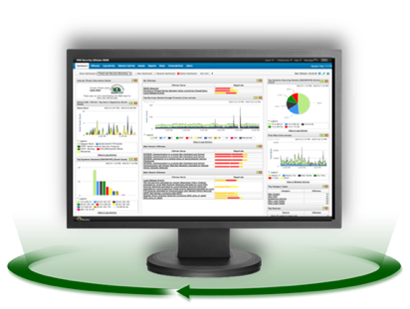
IBM Sense Analytics
SOKFÉLE ADATFORRÁS
Security devices
Servers and mainframes
QRadar Sense Analytics
Priorizált incidensek
és kockázatok
Network and virtual activity
Data activity
Incidensek felismerése
Széles körű adatgyűjtés, tárolás és elemzés
Valós idejű korreláció és fenyegetés-intelligencia
Automatikus eszköz, szolgáltatás és felhasználó felfedezés és profilkészítés
Tevékenység alapozás és anomália felderítése
Application activity
Configuration information
Vulnerabilities and threats
Users and identities
Beépített Intelligencia
Global threat intelligence
Speciális elemzések a fenyegetések megelőzésére, észlelésére és válaszolására

Slide 13
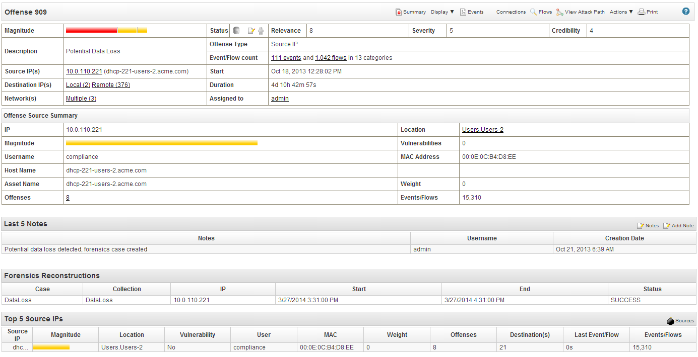
Támadások megelőzésére és helyreállítására vonatkozó kérdések megválaszolása
Mi volt a támadás?
Mennyire hiteles?
Mennyire veszélyes?
Ki a felelős a támadásért?
Honnan indították?
Mit vittek el és mi erre a bizonyíték?
Sérülékenyek a célpontok?
Hány célpontja volt a támadásnak?
Notes:
IBM Security QRadar SIEM analyzes tremendous amounts of data (logs, network flows) and uses context to transform it useful, actionable information as is depicted in this slide. Here's what a security team member would see when they begin to investigate an offense record triggered by a correlation rule. The analyst can quickly see the who, what and where behind the offense and quickly determine if it's a legitimate threat or a false positive.
IBM Security QRadar SIEM is strong from an event-management and analysis perspective and is very effective in detecting threats because it can leverage a broad range of data, analyze it, and apply context from an extensive range of sources. This reduces false positives, and tells users not only what has been exploited but also what kind of activity is taking place. This results in quicker threat detection and response. QRadar continuously monitors data sources across the IT infrastructure, leveraging the full context in which systems are operating. That context includes security and network device logs, vulnerabilities, configuration data, network traffic telemetry, application events and activities, user identities, assets, geo-location, and application content.
This generates a staggering amount of data, and QRadar SIEM leverages it to establish very specific context around each potential area of concern, and uses sophisticated analytics to accurately detect more and different types of threats. For example, a potential exploit of a web server reported by an intrusion detection system can be validated by unusual outbound network activity detected by QRadar network behavioral anomaly detection (NBAD) capabilities.
QRadar uses intelligence, automation and analytics to provide very actionable security information including the number of targets involved in a threat, who was responsible, what kind of attack occurred, whether it was successful, vulnerabilities, evidence for forensics, etc.

Slide 14
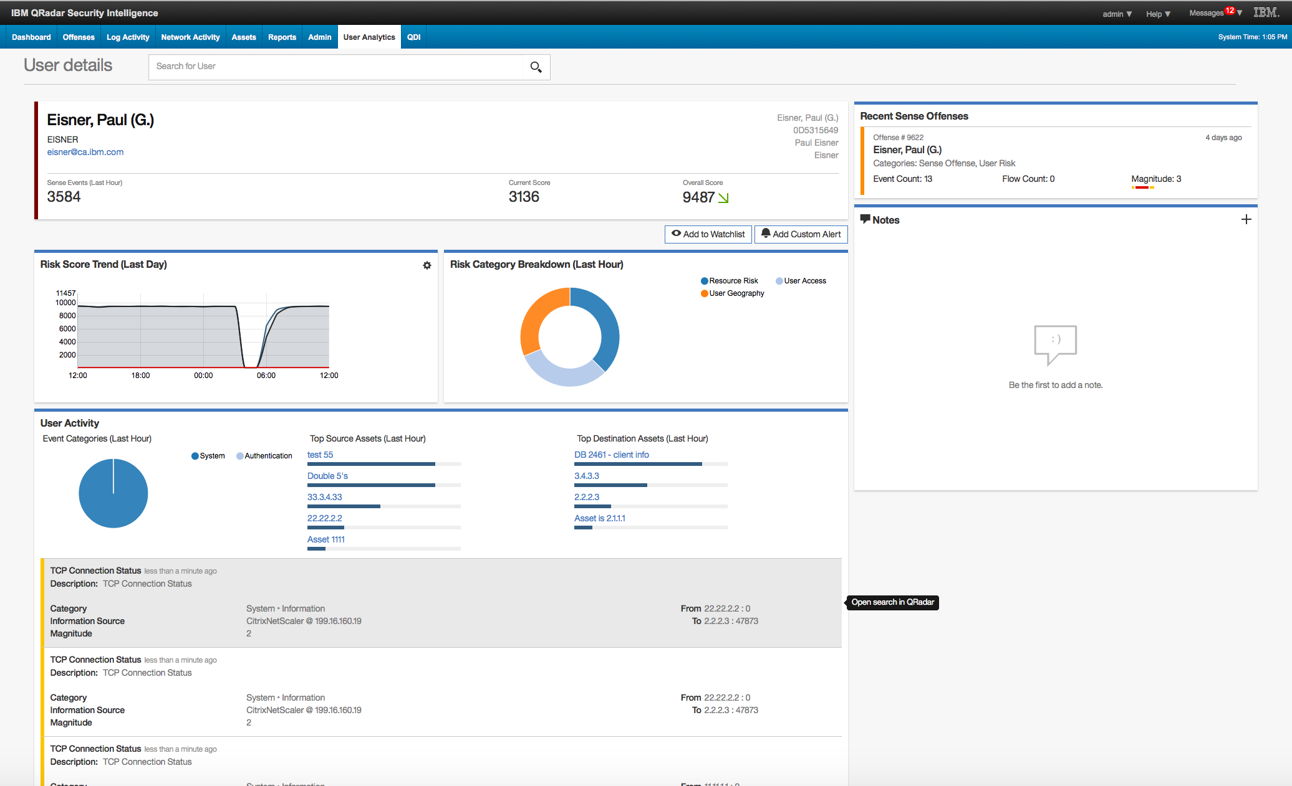
Figyelemmel kísérni a felhasználókra jellemző kockázatot
Nő a kockázat?
Milyen támadásokban vettek részt?
Ki ő?
Milyen a kockázat trendje?
Miket értek el legutoljára ?
Előző aktivitások
Bizonyítékok egy klikkre
Notes:
IBM Security QRadar SIEM analyzes tremendous amounts of data (logs, network flows) and uses context to transform it useful, actionable information as is depicted in this slide. Here's what a security team member would see when they begin to investigate an offense record triggered by a correlation rule. The analyst can quickly see the who, what and where behind the offense and quickly determine if it's a legitimate threat or a false positive.
IBM Security QRadar SIEM is strong from an event-management and analysis perspective and is very effective in detecting threats because it can leverage a broad range of data, analyze it, and apply context from an extensive range of sources. This reduces false positives, and tells users not only what has been exploited but also what kind of activity is taking place. This results in quicker threat detection and response. QRadar continuously monitors data sources across the IT infrastructure, leveraging the full context in which systems are operating. That context includes security and network device logs, vulnerabilities, configuration data, network traffic telemetry, application events and activities, user identities, assets, geo-location, and application content.
This generates a staggering amount of data, and QRadar SIEM leverages it to establish very specific context around each potential area of concern, and uses sophisticated analytics to accurately detect more and different types of threats. For example, a potential exploit of a web server reported by an intrusion detection system can be validated by unusual outbound network activity detected by QRadar network behavioral anomaly detection (NBAD) capabilities.
QRadar uses intelligence, automation and analytics to provide very actionable security information including the number of targets involved in a threat, who was responsible, what kind of attack occurred, whether it was successful, vulnerabilities, evidence for forensics, etc.

Slide 15
A kriminalisztika adatainak kiterjesztése az incidensek és a kockázatok körül
FELISMERÉS
Adatgyűjtés, Tárolás és elemzés
Valós idejű korreláció és biztonsági intelligencia
Automatikus eszköz, szolgáltatás és felhasználó felfedezés és profilkészítés
Tevékenységek megfigyelése és anomália felderítése
Priorizált
incidens
KÁRMENTESÍTÉS
Nyomozás
Folyamatos monitorozás és védelem
Incidens válasz
ADAT-
FORRÁSOK
Beépített Intelligencia
Notes:
QRadar SIEM excels at taking in massive amounts of enterprise-wide security data and using it’s advanced intelligence and analytics to build a prioritized list of incidents requiring immediate attention. Inside the Offenses tab, Security teams can simply right-click any of the entries within the dashboard to see any of the underlying event and flow data to start determining a remediation plan or determine the result was a false positive.
With the arrival of QRadar Incident Forensics, there’s a new option for seeing even more supporting data extracted from the associated network packet data. This problems a new level of clarity to the incident and allows investigators to discover less obvious data connections and previously hidden relationships between multiple IDs.
Using Internet search engine technology, QRadar Incident Forensics presents a simplified user interface accepting free-form text and Boolean logic operators. The search criteria can use any packet capture metadata, reconstructed file metadata or keywords that would reside within a document, email, chat session, etc. Results are normally returned in minutes if not seconds. QRadar Incident Forensics does to full packet capture data what QRadar SIEM does to event and flow data—it helps security teams discover the malicious or anomalous conditions really, really quickly.
Product: QRadar Sense Analytics Engine, QRadar Incident Forensics, QRadar Incidence Response, IBM Managed Security Services

Slide 16
QRadar és Resilient – Szervezett, összekapcsolt és hatékony válasz
MEGHATÁROZOTT VÁLASZADÁSI ELJÁRÁSOK
Optimalizált, hatékony incidensreagálási tervek
HR
Legal
CEO
CISO
IT
VÁLASZADÁS ÖSSZEHANGOLÁSA
Jobb kommunikáció, jobb összehangolás, kisebb zavar a csapatok és az eszközök között.
Risk
Tasks
Ownership
Resilient Incident Response
SZABÁLYOZÁSI INTELLIGENCIA Az adatvédelmi kötelezettségek és aggályok automatikus megismerése
QRadar Security Intelligence
AUTOMATIZÁLÁS
Előre definiált választervek és összehangolás, amelyek csökkentik a függéseket és felgyorsítják a választ
IDS
NIPS
AV
DLP
FW
DBs
Apps
...

Slide 17
One platform, unified visibility

Slide 18
QRadar Sense Platform
Advanced Threat Detection
Insider Threat Detection
Risk & Vulnerability Management
Incident Forensics
Incident Response
Compliance Reporting
Securing Cloud
Third-Party Usage
USE CASES
ACTION
Automation
Dashboards
Visualizations
Workflows
Capability and Threat Intelligence Collaboration Platforms
PRIORITIZED INCIDENTS
QRadar Sense Analytics
Context-Based Analytics
Behavior-Based Analytics
Time-Based Analytics
App Exchange
ENGINE
X-Force Exchange
COLLECTION
Cloud
Infrastructure
Threat Intel
Applications
Business Systems
ON PREM
AS A SERVICE
CLOUD
HYBRID
DEPLOYMENT MODELS

Slide 19
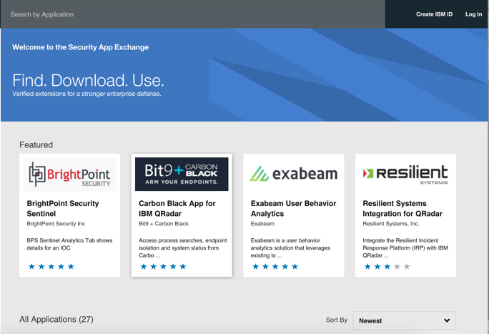
IBM Security App Exchange
Új platform a
Biztonsági Intelligencia Együttműködésre
ELLENŐRZÖTT TARTALOM Tesztelt, validált tartalom minimalizálja a kockázatot, biztosítva az összhangot és a minőséget
INNOVÁCIÓ Új agilis képességek a partnerektől, az IBM-től, a biztonságkutatástól és más gyártóktól
SEBESSÉG Gyors-indítsa a biztonsági operációt a funkciókban gazdag bővítményekkel és integrációkkal
Egyetlen együttműködési platform a gyors reagáláshoz
Új alkalmazások és tartalmak az IBM Security megoldásokhoz
Notes:
Only Certified content for peace of mind and security
Foster collaboration on security intelligence content between security operations teams
Integrated with X-Force Exchange for unified collaboration and correlate current threats with apps
Enable rapid innovation from partners, thousands of customers, universities, and IBM
A unique collaboration platform for security professionals, with more to come..

Slide 20
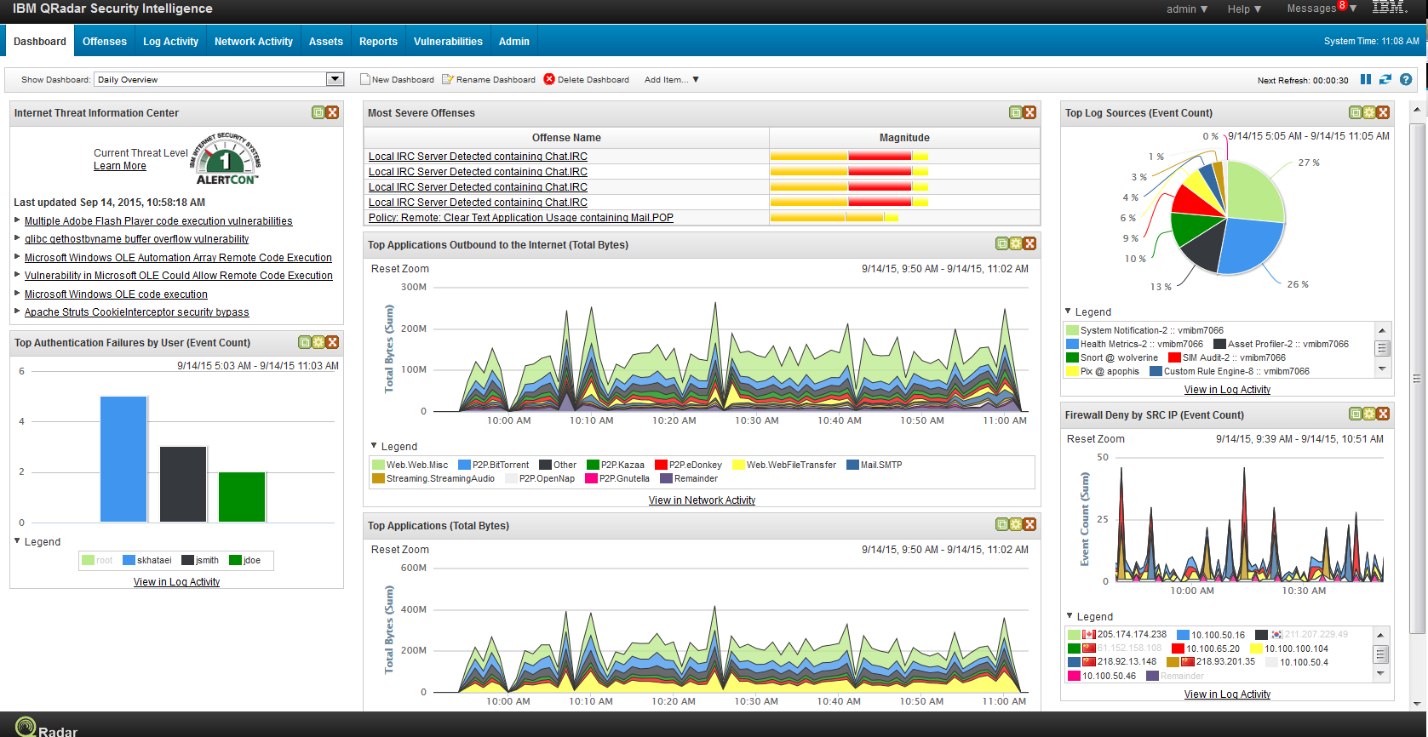
Integrált és egységes architektúra egyetlen webes konzolon
Log Management
Security Intelligence and Sense Analytics
Network Activity Monitoring
Vulnerability and Risk Management
Network Forensics
Incident Response
Notes:
No matter how many QRadar products/applications are leveraged, or how many appliances constitute a customer deployment, all capabilities are leveraged through a single, Web-based console – with all the associated benefits that a common interface delivers in terms of speed of operation, transference of skills, ease of adoption and a universal learning curve.
Designed from scratch to integrate Log Management, SIEM, and Risk Management in one solution, it will deliver massive log management scale without any compromise on SIEM “Intelligence.” Unlike other offerings, QRadar users can jump from log events, to network flows, to risk and compliance policy reports and prioritized lists of network-wide vulnerabilities.

Slide 21
IBM QRadar: folyamatos fejlesztés az ügyfelek visszajelzési alapján
Incident Response
Build and execute an automated incident response plans
Security Intelligence on Cloud
Flexible solution that can deploy as either a true SaaS offering or combine with hybrid cloud environments to improve visibility into cloud-based applications
Network Forensics
Incident forensics and packet captures
Vulnerability and Risk Management
Real-time vulnerability scanning and prioritizations, combined with configuration analysis, policy monitoring, and risk assessment
Log Management
Identity management, complete log management, and compliance reporting
SIEM
SIM and VA integration
Platform evolution based on client needs
Client Needs
Flow Visualization and NBAD
Anomaly detection and threat resolution
2002 – 2005 | 2006 – 2007 | 2008 – 2009 | 2010 – 2013 | 2014 | 2015 | 2016
Notes:
Security Intelligence for IBM has already been a ten year journey of development, and one that will certainly continue into the foreseeable future. We began by looking at network data and added on to that the log source information, then asset and device configuration data, vulnerability data, and now forensic data. Each extension to the platform addresses the changing nature of cyber criminal attacks as the traditional network perimeter disappeared with BYOD mobile and social computing.
Forensics and full packet captures are yet another feed of security data helping teams add more context and color to investigations so they can understand the underlying conditions more quickly. It complements and extends the application identification technology we developed called QFlow by doing more than just sampling the payloads to retaining and reconstructing anything sent over the network into its original form.

Slide 22
The power to act – at scale

Slide 23
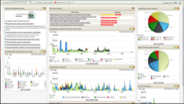
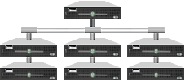
Optimalizált hardver és szoftver architektúra a teljesítmény és a gyors implementálás érdekében
IBM QRadar Security Intelligence Platform
Skálázható appliance
architektúra
Megosztott moduláris infrastruktúra
Könnyen telepíthető, skálázható felépítés az appliance-ek egymásra építésével
Nem szükséges külső adatbázis vagy tároló eszköz
Automatikus HA és DR megvalósítás
Virtuális kivitel is választható
Notes:
Security Intelligence can be delivered through a family of QRadar products
For many customers the starting point has to be solving their log management challenge, which is why we offer a family of log management only appliances. Even here though there are benefits to the integration we described earlier. Unlike any other solution in the market today, these log management appliances can be upgraded to full SIEM capability by the simple addition of a license key.
QRadar Log Manager collects, archives, analyzes and reports on events across a distributed network and helps automate regulatory and policy compliance reporting activities. Full SIEM provides complete integration of log management with threat, fraud, network and security intelligence. Network activity data, vulnerability assessment and external threat data are added as data sources along with sophisticated correlation and behavioral analytics.
For some customers full SIEM scale can be met with a single appliance…for others who have higher scale, or remote collection and storage requirements, QRadar processors enable massive deployments. This horizontal, stackable expansion supports massive scale and geographic distribution – while maintaining exactly the same user experience.
For application layer visibility and forensic content capture, Flow collectors we call QFlow and VFlow can be deployed in customers’ physical or virtual infrastructures. These monitors provide extensive application-level surveillance of all activity at key locations. For the ultimate content capture QRadar Packet Capture devices can be strategically located throughout a network to temporarily collect everything passing through the wires.

Slide 24
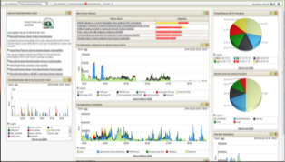
IBM QRadar támogatja több száz külső gyártó alkalmazását
IBM QRadar Security Intelligence Platform
Notes:
This is a quick view of some of the more prevalent solutions found in todays market for which we have out-of-the-box integrations already in place. IBM Security also has a dedicated integrations team (I-team) focused on constantly adding more support for the most frequently requested technologies used by our customers. Each maintenance release—which come out at a rate of once per calendar quarter—will include new support for IBM and third-party offerings.

Slide 25
A legmeghatározóbb különbségek
Hálózati eszközök automatikus felderítése
Proaktív sebezhetőségi vizsgálatok és felkészülés
Incidens vizsgálat és válasz
Hatékony és gyors nyomozás és válaszadás
Egyszerű telepítés
Adaforrások és eszközök automatikus illesztése
Előre telepített szabályok és riportok
Azonnali használat
Automatikus frissítések
A legújabb támadási vektorok és támadók felismerése
App Exchange
Külső gyártók az IBM által bevizsgált alkalmazásai
“IBM QRadar bevezetése kb. háromszor gyorsabb bármelyik másik SIEM eszköz bevezetéséhez képest.”
2014 Ponemon Institute, LLC
“Ezek az eszközök lehetővé teszik számunkra, hogy több mint 2,2 millió eseményt kezeljünk naponta, és még mindig tartsuk a fejünket a víz felett."
David Shipley, Director of Strategic Initiatives and IT, University of New Brunswick
Notes:
Simplified deployment delivers results in days
Syslog device detection configures log data sources
Passive flow asset detection populates asset database
Out-of-the-box rules and reports reduce incident investigations and meet compliance mandates
Real-time events keep information current
Immediate discovery of network asset additions triggers proactive vulnerability scans, configuration comparisons and policy compliance checks
Daily and weekly updates to rules, reports, vulnerabilities, patches, searches, support modules, protocols and signatures
Source: IBM Sales Win (internal use only – need to keep as a blinded reference) https://w3-connections.ibm.com/wikis/home?lang=en-us#!/wiki/W2d9715d42210_49a1_9f51_74d34634effc/page/Southern%20New%20Hampshire%20University%20increases%20its%20security%20intelligence%20with%20IBM%20Security%20QRadar
The average time to implement QRadar was 5.5 months versus 15.2 months (nearly 3X) for other market-leading competitor solutions.
Source: Ponemon Institute’s Independent Research study was based one-to-one confidential interviews with a learned group of 25 IT and IT security practitioners conducted by Ponemon Institute, LLC, February, 2014.
David Shipley: http://www-03.ibm.com/software/businesscasestudies?synkey=E852486L79716Z79

Slide 26
QRadar Summary

Slide 27
QRadar Security Intelligence számokban
Ügyfelek száma – 6,000+
Alkalmazások száma– 60+
Biztonsági intelligencia források – 7+
STIX/TAXII, x-Force, Threatstream, iSight, Brightpoint, RiskIQ, Custom
Gyári riportok – 1664
Compliance, Configuration and Change Management, Executive, Log Source, Network Management, Security, Usage Monitoring, Virtual Infrastructure, Vulnerability Management
Korrelációs szabályok / Építő elemek – 632
Támogatott eszközök, Rendszerek, Alkalmazások és Felhő szolgáltatások– 500+
Külső gyártók sérülékenységi szkenner alkalmazásai – 20
Qualys, Rapid7, Tenable, Tripwire, AppScan,…
Hálózati aktivitás (flow) források– 5
NetFlow, J-Flow, sFlow, vFlow, QFlow
Skálázhatóság – > 1.5m EPS implementáció
Átlagos bevezetési idő – átlag < 5 months
Gartner Magic Quadrant helyezés – 1

Slide 28
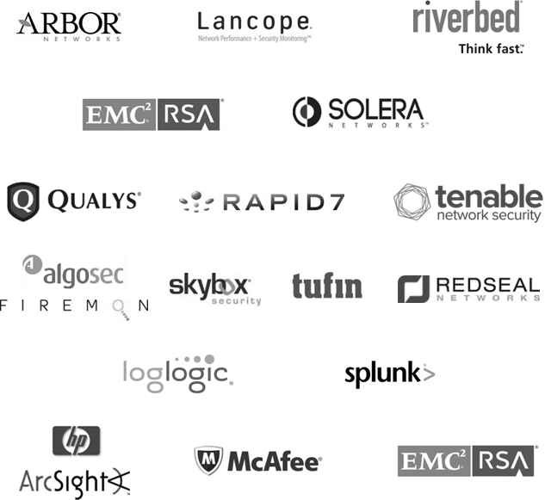
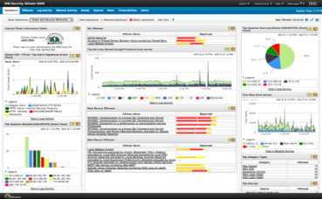
Hét fő funkció egyetlen termékben, közös platformon
 | Tradicionális SIEM 7 termék 7 gyártótól | IBM Security Intelligence and Analytics
Flows
Packets
Vulnerabilities
Configurations
Logs
Events
Response
An integrated, unified architecture in a single web-based console
IBM Security QRadar Security Intelligence Platform
Notes:
<Presenter note: Please don’t leave this slide with your prospects.>
With traditional SIEM, as many as 6 products from 6 different vendors are needed. But with IBM Security Intelligence and Analytics, you get an integrated and unified architecture in one single web-based console that will help increase visibility and ultimately reduce costs of having to maintain multiple point-product and even manual solutions.

Slide 29
Elemzők értékelései
IBM Security Intelligence
Leader in the Gartner Magic Quadrant since 2009 Security Information and Event Management (SIEM)
#1 in SIEM market share by Gartner and IDC
#1 IDC Security Vulnerability Management (including SIEM)
2016 SANS Best SIEM Solution
“By integrating the UBA App with QRadar, and making it easy to deploy via the Security App Exchange, IBM has established a strong differentiator in the increasingly crucial field of security analytics.” TBRI
Notes:
Consistent Leader in Gartner Magic Quadrant for Security Information and Event Management (SIEM): 2009, 2010, 2011, 2012, 2013, 2014 (#1), 2015 (#1) with steady movement Up and to the Right
IBM is rated #1 for on “Ability to Execute”, “Completeness of Vision”
Frost & Sullivan: 2013 Global Customer Value Leadership Award Applied Security Intelligence in SIEM/LM
Thousands of deployments worldwide
Industry awards include:
Global Excellence in Surveillance Award from InfoSecurity Products Guide
“Hot Pick” by Information Security magazine
AlwaysOn Global 250
GovernmentVAR 5-Star Award

Slide 30
Egyetlen platform a biztonsági operáció (SOC) megvalósítására
Advanced Threat Detection
Insider Threat Detection
Risk and Vulnerability Management
Incident Forensics
Incident Response
Compliance Reporting
Securing Cloud
Third-Party Usage
Notes:
This is just a summary of what we’ve been trying to communicate over the course of this presentation. The benefits to adopting or switching to QRadar Security Intelligence include:
Faster identification of high priority issues – so you can quickly build an effective remediation plan
Consolidation of data silos – so you can see the relationships between event and threat data and tune your implementation for even greater accuracy
Ability to address regulation mandates – so you can pass any audit coming your way
Stop insider fraud and abuse – so you can contain and control and data tampering, loss, etc.,
Tighten your security profile by reviewing assets configurations and removing vulnerabilities – so you are less exposed to commonly occurring attacks

Slide 31
További információ az IBM Security megoldásairól
No. 1
Leggyorsabban növekvő gyártó
Látogasson el honlapunkra ibm.com/security
Elemző értékelte az IBM Security-t mint VEZETŐ GYÁRTÓT
24
Nézze YouTube csatornánkat IBM Security Channel
Ország, ahol az IBM menedzselt biztonsági szolgáltatást nyújt
130+
Olvassa biztonsági blogunkat SecurityIntelligence.com
12K+
Ügyfél világszerte
Csatlakozzon az IBM X-Force-ra xforce.ibmcloud.com
90%
A Fortune 100 cégeknek
Kövessen minket a Twitter-en @ibmsecurity
V2016-02-15
Notes:
IBM Listed as Fastest Growing Vendor in Gartner Worldwide Security Software Study, based on 2014 Revenue Source: https://www-03.ibm.com/press/us/en/pressrelease/47087.wss#release
Note: Actual number of countries where IBM delivers managed security services is 134 as of Nov. 2015
90% of the Fortune 100 companies (based on 2014 Fortune 500 rankings)
Source: 2015 MI IBM Security Heatmap

Slide 32
SHARED UNDER NDA

Slide 33
QRadar QFlow - Differentiated by network flow analytics
Network traffic doesn’t lie. Attackers can stop logging and erase their tracks, but can’t cut off the network (flow data)
Deep packet inspection for Layer 7 flow data
Pivoting, drill-down and data mining on flow sources for advanced detection and forensics
Helps detect anomalies that might otherwise get missed
Enables visibility into attacker communications
Notes:
While log events are critical, they leave gaps in visibility. The first thing an attacker will do when they compromise a system is to turn off logging and erase their tracks. Traditional SIEMs are blind at this point. However, the attacker can’t turn off the network or they cut themselves off as well.
In addition to filling in the visibility picture, network activity can also be used to passively build up an asset database and profile your assets. A machine that has received and responded to a connection on port 53 UDP is obviously a DNS server. Or a machine that’s accepted connections on 139 or 445 TCP is a Windows server. Adding application detection can confirm this not only at a port level, but the application data level.
33

Slide 34
QRadar QFlow fully supports five key use cases
Detection of zero-day threats through traffic profiling
Detection of malware and virus/worm activity through behavior profiling and anomaly detection across all network traffic (applications, hosts, protocols, areas of the network)
Compliance with policy and regulatory mandates via deep analysis of application data and protocols
Alerting on out-of-policy behavior and traffic, such as traffic being sent to untrustworthy geographical regions or unsecure protocols
Social media monitoring
Anomaly detection and DPI-based content capture that identify and alert on social media-related threats and risks
Advanced incident analysis via correlation of flow data with log data
Accurate prioritization of incident data and reduction of false positives by correlating security events with actual network traffic
Continuous profiling of assets
Collection and monitoring of continuous information feed from hosts, assets and services, allowing QRadar SIEM to automatically identify and classify new assets and discover what ports and services they are running

Slide 35
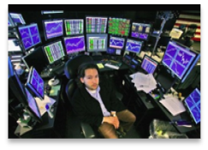
Vulnerability and risk management processes are overloaded
Problems in current risk and vulnerability management
Data overload inhibitor
!
Patching and remediation processes overwhelmed
Network Security and usage not considered
CVE
CVE
CVE
CVE
CVE
CVE
CVE
CVE
CVE
CVE
CVE
Your Vulnerabilities
CVE
CVE
CVE
CVE
CVE
CVE
CVE
CVE
CVE
CVE
CVE
CVE
CVE
CVE
CVE
CVE
CVE
CVE
CVE
CVE
Your Vulnerabilities
CVE
CVE
CVE
CVE
CVE
CVE
CVE
CVE
CVE
CVE
CVE
CVE
CVE
CVE
CVE
CVE
CVE
CVE
CVE
CVE
CVE
CVE
CVE
CVE
CVE
CVE
CVE
CVE
CVE
CVE
CVE
CVE
CVE
CVE
CVE
CVE
CVE
CVE
CVE
CVE
CVE
CVE
CVE
CVE
CVE
CVE
CVE
CVE
CVE
CVE
CVE
CVE
CVE
CVE
CVE
CVE
CVE
Your Vulnerabilities
CVE
CVE
CVE
CVE
CVE
CVE
CVE
CVE
CVE
CVE
CVE
CVE
CVE
CVE
CVE
CVE
CVE
CVE
CVE
CVE
CVE
CVE
CVE
CVE
CVE
CVE
CVE
CVE
CVE
CVE
CVE
CVE
CVE
CVE
CVE
CVE
CVE
CVE
CVE
CVE
CVE
CVE
CVE
CVE
CVE
CVE
CVE
CVE
CVE
CVE
CVE
CVE
CVE
Siloed system limitations
CVE
CVE
CVE
CVE
CVE
CVE
CVE
CVE
CVE
CVE
CVE
CVE
CVE
CVE
CVE
CVE
CVE
CVE
CVE
CVE
CVE
CVE
CVE
CVE
CVE
CVE
CVE
CVE
CVE
CVE
CVE
CVE
CVE
CVE
CVE
CVE
CVE
CVE
CVE
CVE
CVE
CVE
CVE
CVE
CVE
CVE
CVE
CVE
CVE
CVE
CVE
CVE
CVE
CVE
CVE
CVE
CVE
CVE
CVE
CVE
CVE
CVE
CVE
CVE
CVE
CVE
CVE
CVE
CVE
CVE
CVE
CVE
CVE
CVE
CVE
CVE
CVE
CVE
CVE
CVE
CVE
CVE
CVE
CVE
CVE
CVE
CVE
CVE
CVE
CVE
CVE
CVE
CVE
CVE
CVE
CVE
CVE
CVE
CVE
CVE
CVE
CVE
CVE
CVE
CVE
CVE
CVE
CVE
CVE
CVE
CVE
CVE
CVE
CVE
CVE
CVE
CVE
CVE
CVE
CVE
CVE
CVE
CVE
CVE
CVE
CVE
CVE
CVE
CVE
CVE
CVE
CVE
CVE
CVE
CVE
CVE
CVE
CVE
CVE
!
CVE
CVE
CVE
CVE
CVE
CVE
CVE
CVE
CVE
CVE
CVE
CVE
CVE
CVE
CVE
CVE
CVE
CVE
CVE
CVE
CVE
CVE
CVE
CVE
CVE
CVE
CVE
CVE
CVE
CVE
CVE
CVE
CVE
CVE
CVE
CVE
CVE
CVE
Time spend screen switching
Integration and deployment costs
CVE
CVE
CVE
CVE
CVE
CVE
CVE
CVE
CVE
CVE
CVE
CVE
CVE
CVE
CVE
CVE
CVE
CVE
CVE
CVE
CVE
CVE
CVE
CVE
CVE
CVE
CVE
CVE
CVE
CVE
CVE
CVE
CVE
CVE
CVE
CVE
CVE
CVE
CVE
CVE
CVE
CVE
CVE
CVE
CVE
CVE
CVE
CVE
CVE
CVE
CVE
CVE
CVE
CVE
CVE
CVE
CVE
CVE
CVE
CVE
CVE
CVE
CVE
CVE
CVE
CVE
CVE
CVE
CVE
CVE
CVE
CVE
CVE
CVE
CVE
CVE
CVE
CVE
CVE
CVE
CVE
CVE
CVE
CVE
CVE
CVE
CVE
CVE
CVE
CVE
CVE
CVE
CVE
CVE
CVE
CVE
CVE
CVE
CVE
CVE
CVE
CVE
CVE
CVE
CVE
CVE
CVE
CVE
CVE
CVE
CVE
CVE
CVE
CVE
CVE
CVE
CVE
CVE
CVE
CVE
CVE
CVE
CVE
CVE
CVE
CVE
CVE
CVE
CVE
CVE
CVE
CVE
CVE
CVE
CVE
CVE
CVE
CVE
CVE
CVE
CVE
CVE
CVE
CVE
CVE
CVE
CVE
CVE
CVE
CVE
CVE
CVE
CVE
CVE
CVE
CVE
CVE
CVE
CVE
CVE
CVE
CVE
CVE
CVE
CVE
CVE
CVE
CVE
CVE
CVE
CVE
CVE
CVE
CVE
CVE
CVE
CVE
CVE
CVE
CVE
CVE
CVE
Hidden risks remain
CVE
CVE
CVE
CVE
!
Time spent searching
Assets and vulnerabilities remain hidden
Has that been patched?
Has or will it been exploited?
Does my firewall block it?
Does my IPS block it?
Does it matter?
Leaves unanswered questions
Creates security gaps
Notes:
Data overload: ‘Ocean’ of issues overwhelming patching and remediation processes. You should have the ability to identify and prioritize vulnerabilities based on context (link to intelligent)
b. Siloed system limitations: Multiple systems housing vulnerabilities for network, application, databases create huge inefficiencies in both time and effort. You should have the ability to integrate vulnerability management processes and data into a single platform (link to integrated)
c. Hidden risks remain (consider changing): Dated information and missing coverage allows security weaknesses to remain hidden. You should have the ability to discover new assets and scale to new environments with ease (link to automated)
35

Slide 36
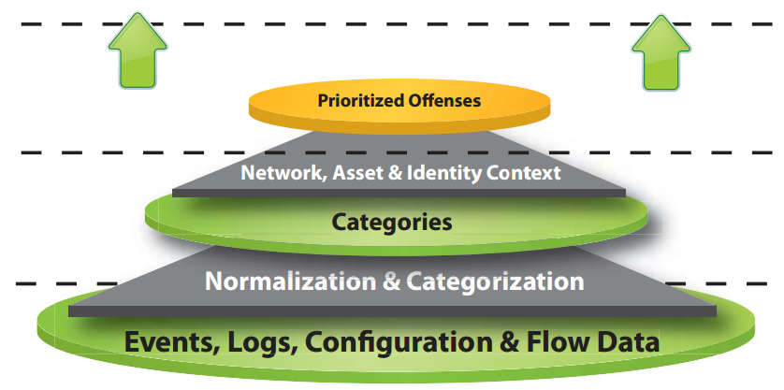
Introducing IBM Security QRadar Vulnerability Manager
Solution Highlights
First VA solution integrated with Security Intelligence
Dramatically improving actionable information through rich context
Reducing total cost of ownership through product consolidation
Providing unified view of all vulnerability information
Log Manager
SIEM
Network Activity Monitor
Forensics
Vulnerability Manager
Security Intelligence is extending and transforming Vulnerability Management – just as it did to Log Management
Notes:
36

Slide 37
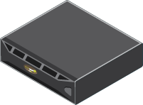
Reducing the data overload with complete context from Security Intelligence
CVE
CVE
CVE
CVE
CVE
CVE
CVE
CVE
CVE
CVE
CVE
CVE
CVE
Your Vulnerabilities
CVE
CVE
CVE
CVE
CVE
CVE
CVE
CVE
CVE
CVE
CVE
CVE
Your Vulnerabilities
CVE
CVE
CVE
CVE
CVE
CVE
CVE
CVE
CVE
CVE
CVE
CVE
CVE
Your Vulnerabilities
CVE
CVE
CVE
Your Vulnerabilities
CVE
CVE
CVE
CVE
CVE
CVE
CVE
CVE
CVE
CVE
CVE
CVE
CVE
Not active
CVE
CVE
CVE
CVE
CVE
CVE
CVE
CVE
CVE
CVE
CVE
CVE
CVE
CVE
CVE
CVE
CVE
CVE
CVE
CVE
CVE
CVE
CVE
CVE
CVE
CVE
CVE
CVE
CVE
CVE
CVE
CVE
CVE
CVE
CVE
CVE
CVE
CVE
CVE
CVE
CVE
CVE
CVE
CVE
CVE
CVE
CVE
CVE
CVE
CVE
CVE
CVE
CVE
CVE
CVE
CVE
CVE
CVE
CVE
CVE
CVE
CVE
CVE
CVE
CVE
CVE
CVE
CVE
CVE
CVE
CVE
CVE
CVE
CVE
CVE
CVE
CVE
CVE
CVE
CVE
CVE
CVE
CVE
CVE
CVE
CVE
CVE
CVE
CVE
CVE
CVE
CVE
CVE
CVE
CVE
CVE
CVE
CVE
CVE
CVE
CVE
CVE
CVE
CVE
CVE
CVE
CVE
CVE
CVE
CVE
CVE
CVE
CVE
CVE
CVE
CVE
CVE
CVE
CVE
CVE
CVE
CVE
CVE
CVE
CVE
CVE
CVE
CVE
CVE
CVE
CVE
CVE
CVE
CVE
CVE
CVE
CVE
CVE
CVE
CVE
CVE
CVE
CVE
CVE
CVE
CVE
CVE
CVE
CVE
CVE
CVE
CVE
CVE
CVE
CVE
CVE
CVE
CVE
CVE
CVE
CVE
CVE
CVE
CVE
CVE
CVE
CVE
CVE
CVE
CVE
CVE
CVE
CVE
CVE
CVE
CVE
CVE
CVE
CVE
CVE
CVE
CVE
CVE
CVE
CVE
CVE
CVE
CVE
CVE
CVE
CVE
CVE
CVE
CVE
CVE
CVE
Patched
CVE
CVE
CVE
CVE
CVE
CVE
CVE
CVE
CVE
CVE
CVE
CVE
CVE
CVE
CVE
CVE
CVE
CVE
CVE
CVE
CVE
CVE
CVE
CVE
CVE
CVE
CVE
CVE
CVE
CVE
CVE
CVE
CVE
CVE
CVE
CVE
CVE
CVE
CVE
CVE
CVE
CVE
CVE
CVE
CVE
CVE
CVE
CVE
CVE
CVE
CVE
CVE
CVE
CVE
CVE
CVE
CVE
CVE
CVE
CVE
CVE
CVE
CVE
CVE
CVE
CVE
CVE
CVE
CVE
CVE
CVE
CVE
CVE
CVE
CVE
CVE
CVE
CVE
CVE
CVE
CVE
CVE
CVE
CVE
CVE
CVE
CVE
CVE
CVE
CVE
CVE
CVE
CVE
CVE
CVE
CVE
CVE
CVE
CVE
CVE
CVE
CVE
CVE
CVE
CVE
CVE
CVE
CVE
CVE
CVE
CVE
CVE
CVE
CVE
CVE
CVE
CVE
CVE
CVE
CVE
CVE
CVE
CVE
CVE
CVE
CVE
CVE
CVE
CVE
CVE
CVE
CVE
CVE
CVE
CVE
CVE
CVE
CVE
CVE
CVE
CVE
CVE
CVE
CVE
CVE
CVE
CVE
CVE
CVE
CVE
CVE
CVE
CVE
CVE
CVE
CVE
CVE
CVE
CVE
CVE
CVE
CVE
CVE
CVE
CVE
CVE
CVE
CVE
CVE
CVE
CVE
CVE
CVE
CVE
CVE
CVE
CVE
CVE
CVE
CVE
CVE
CVE
CVE
CVE
CVE
CVE
CVE
CVE
CVE
CVE
CVE
CVE
CVE
CVE
CVE
CVE
CVE
CVE
CVE
CVE
CVE
CVE
Critical
CVE
CVE
CVE
CVE
CVE
CVE
CVE
CVE
CVE
CVE
CVE
CVE
CVE
CVE
CVE
CVE
CVE
CVE
CVE
CVE
CVE
CVE
CVE
CVE
CVE
CVE
CVE
CVE
CVE
CVE
CVE
CVE
CVE
CVE
CVE
CVE
CVE
Blocked
CVE
CVE
CVE
CVE
CVE
CVE
CVE
CVE
CVE
CVE
CVE
CVE
CVE
CVE
CVE
CVE
CVE
CVE
CVE
CVE
CVE
CVE
CVE
CVE
CVE
CVE
CVE
CVE
CVE
CVE
CVE
CVE
CVE
CVE
CVE
CVE
CVE
CVE
CVE
CVE
CVE
CVE
CVE
CVE
CVE
CVE
CVE
CVE
CVE
CVE
CVE
CVE
CVE
CVE
CVE
CVE
CVE
CVE
CVE
CVE
CVE
CVE
CVE
CVE
CVE
CVE
CVE
CVE
CVE
CVE
CVE
CVE
CVE
CVE
CVE
CVE
CVE
CVE
CVE
CVE
CVE
CVE
CVE
CVE
CVE
CVE
CVE
CVE
CVE
CVE
CVE
CVE
CVE
CVE
CVE
At risk!
CVE
CVE
CVE
CVE
CVE
CVE
CVE
CVE
CVE
CVE
CVE
CVE
CVE
CVE
CVE
CVE
CVE
CVE
CVE
CVE
CVE
CVE
CVE
CVE
CVE
CVE
CVE
CVE
CVE
CVE
CVE
CVE
CVE
CVE
CVE
CVE
CVE
CVE
CVE
CVE
CVE
CVE
CVE
CVE
CVE
CVE
CVE
CVE
CVE
CVE
CVE
CVE
CVE
CVE
CVE
CVE
CVE
CVE
CVE
CVE
CVE
CVE
CVE
CVE
CVE
CVE
CVE
CVE
CVE
CVE
CVE
CVE
CVE
CVE
CVE
CVE
CVE
Exploited!
CVE
CVE
CVE
CVE
CVE
CVE
CVE
CVE
CVE
CVE
CVE
Other VMs
QRadar QVM
Notes:
37
Integration with Endpoint Manager reveals what vulnerabilities will be patched
Leveraging QRM, QVM will tell what vulnerabilities are blocked by your IPS and FW
Using QFlow QVM will tell if the vulnerable application is active
The prioritized list of vulnerabilities you should deal with ASAP
Leveraging x-Force and SIEM focus on the vulnerable assets communicating with potential threats
SIEM tells you what vulnerabilities have been attacked!
37

Slide 38
How QVM Works
Not Active: By leveraging QFlow, QVM can tell if the vulnerable application is active
CVE
CVE
CVE
Patched: By leveraging BigFix, QVM understands what vulnerabilities will be patched
CVE
CVE
CVE
CVE
CVE
CVE
CVE
Your Vulnerabilities
CVE
CVE
CVE
CVE
CVE
Not active
CVE
CVE
CVE
CVE
Blocked: By leveraging network topology, QVM can understand what vulnerabilities are blocked by firewalls and IPSs and XGS
CVE
CVE
CVE
CVE
CVE
CVE
CVE
CVE
CVE
CVE
CVE
CVE
CVE
CVE
CVE
CVE
CVE
CVE
CVE
CVE
CVE
CVE
CVE
CVE
CVE
CVE
CVE
CVE
CVE
CVE
CVE
CVE
CVE
CVE
CVE
CVE
CVE
CVE
CVE
CVE
CVE
CVE
Patched
Critical: By leveraging its vulnerability knowledge base, remediation flow and QRM policies, QVM can identify business critical vulnerabilities
CVE
CVE
CVE
CVE
CVE
CVE
CVE
CVE
CVE
CVE
CVE
CVE
CVE
CVE
CVE
CVE
CVE
CVE
CVE
CVE
CVE
CVE
CVE
CVE
CVE
CVE
CVE
CVE
CVE
CVE
CVE
CVE
CVE
CVE
CVE
CVE
CVE
CVE
CVE
CVE
CVE
CVE
CVE
CVE
Critical
CVE
CVE
CVE
CVE
CVE
CVE
CVE
CVE
CVE
CVE
CVE
Blocked
CVE
CVE
CVE
CVE
CVE
CVE
CVE
CVE
At Risk: By utilizing X-Force threat and SIEM security incident data, coupled with QFlow network traffic visibility, QVM can tell if vulnerable assets are communicating with potential threats
CVE
CVE
CVE
CVE
CVE
CVE
CVE
CVE
CVE
CVE
CVE
CVE
CVE
CVE
CVE
CVE
CVE
At risk!
CVE
CVE
CVE
CVE
CVE
CVE
CVE
CVE
CVE
CVE
CVE
CVE
CVE
CVE
CVE
CVE
CVE
CVE
CVE
CVE
CVE
Exploited!
CVE
CVE
CVE
Exploited: By leveraging SIEM correlation and XGS data, QVM can reveal what vulnerabilities have been exploited
CVE
CVE
CVE
Notes:
38
Integration with Endpoint Manager reveals what vulnerabilities will be patched
Leveraging QRM, QVM will tell what vulnerabilities are blocked by your IPS and FW
Using QFlow QVM will tell if the vulnerable application is active
The prioritized list of vulnerabilities you should deal with ASAP
Leveraging x-Force and SIEM focus on the vulnerable assets communicating with potential threats
SIEM tells you what vulnerabilities have been attacked!
38

Slide 39
QRadar Incident Forensics – Responding quickly to incidents
In 2012, 38% of targets were attacked again once the original incident was remediated.
In 2013, it took organizations 32 days on average to resolve a cyber-attack
Attackers spend an estimated 243 days on a victim’s network before being discovered
63% of victims made aware of their breaches by an external organization
Annual cost of cyber-crime in the U.S. now stands at $11.56 million per organization
How to avoid becoming a repeat victim?
Has our organization been compromised?
When was our security breached?
What type of attack is it?
What resources and assets are at risk?
How do we identify the attack?
Notes:
http://www.eweek.com/security/cyber-crime-costs-continue-to-rise-study.html
https://www.mandiant.com/news/release/mandiant-releases-annual-threat-report-on-advanced-targeted-attacks1/

Slide 40
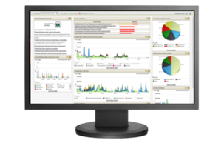
Next generation network forensics: know what happened, fast
Our Security Intelligence platform delivers powerful capabilities IT Security Operations Teams
Introducing QRadar Incident Forensics:
Leveraging the strengths of QRadar to optimize the process of investigating and gathering evidence on advanced attacks and data breaches
Tells you exactly when an incident occurred
Integrated with QRadar to discover true offenses and prioritize forensics investigations
Enables search-driven data exploration to return detailed, multi-level results in seconds
Merges powerful forensics capability with simplicity
Full packet capture for complete session reconstruction
Unified view of all flow, user, event, and forensic information
Retrace activity in chronological order
Delivers intelligence to guide forensics investigations
Visually construct threat actor relationships
Builds detailed user and application profiles across multiple IDs

