Slide 1
Cégbemutató, rövid áttekintés
Keszler Mátyás
Territory Manager, Hungary

Slide 2
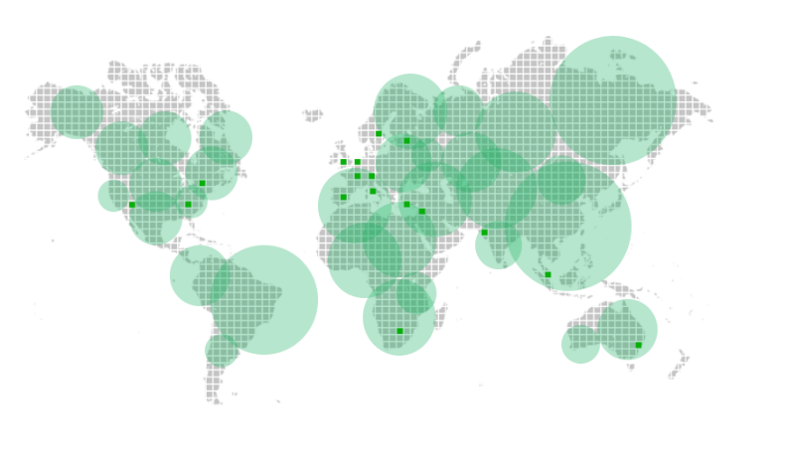
Üdvözli a Veeam
Globális cég, központja Baar, Svájc
Alapítás éve: 2006
A bevétel és az ügyfél szám folyamatos növekedése
Eredmény
(M, USD)
Célunk
1 Milliárd USD
2018-ra
1950 munkatárs
Több, mint
37 000 ProPartners

Slide 3
Üdvözli a Veeam
Ügyfél szám
215 000
ügyfél világszerte
Több, mint 4000 havonta
Több, mint 12 millió VM védve általunk
48 %
a Global 2000
70%
a Fortune 500
3x –os iparági elégedettség
A Veeam ügyfelek:
Elégedettség: 8,5\10
A megújítás valószínűsége: 8,8\10
A termék funkciói: 8,4\10
Értékesítési hatékonyság: 8,8\10
A Veeam ügyfelei

Slide 4
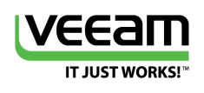
2015 Net Promoter Score (NPS)
Mi az az Net Promoter Score (NPS)?
Ez egy sztenderdizált ügyfél elégedettségi index, amely azt méri, hogy az ügyfél mennyire ajánlaná más cégeknek az adott terméket, vagy szolgáltatást.
Annak érdekében, hogy ezt megfelelő perspektívába helyezzük: Összehasonítás a többi branddel!
Southwest Airlines (62)
Pandora (59)
Apple iPhone (63)
-100
0
10
23
30
100
62
Legalacsonyabb szám
Átlagos iparági mérőszám
Legmagasabb szám
Tipikus vállalati átlag szám
Források:
-Primary Intelligence, Veeam Customer Satisfaction Research, February 2015
-Temkin Group, Tech Vendor NPS Benchmark, July 2014
-2015 NPS Lookup at www.npsbenchmarks.com
3x
Az iparági átlagnak
Notes:
Optional / Hidden slide in case you want to better explain what NPS is. 2016 NPS will likely come out in March/April.
Best in slideshow mode due to animations.
First explain what NPS is – definition on screen.
Then explain how scores range from -100 to 100 (lowest possible score to highest). Know that scores that range between 10 and 30 are traditionally average scores (yet scores and averages range by industry) as customer expectations often differ by industry. While no negative scores are listed here, now that a negative score is rather likely as the NPS calculator is a difficult grader.
Out of the software industry companies we were able to find, the average score was a 23.
Veeam was 3x the industy average, far and away the industry leader, with an NPS of 62. (up from 47 last year).
This places us in the mix of some of the biggest and most beloved brands in the world – see where we compare to Pandora radio, Southwest Airlines, and the Apple iPhone just to name a few.

Slide 5









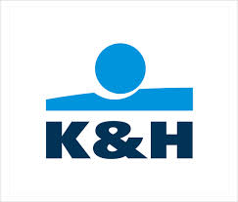




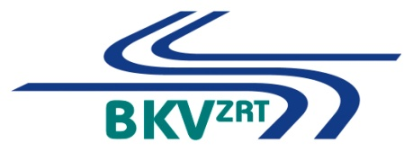




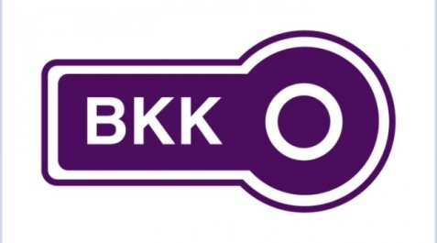
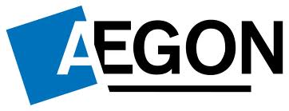


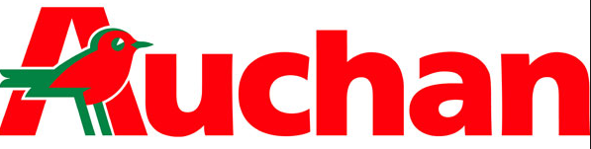



Slide 6
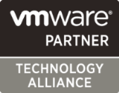
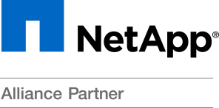
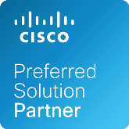


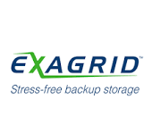
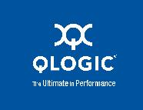
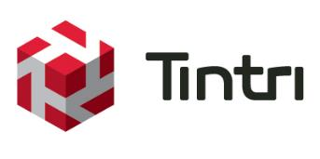


Stratégiai szövetségeseink
Partners Global Alliance
Az öt legnagyobb TAP (Technology Alliance Partner)

Slide 7



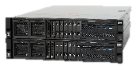



IBM Virtualizált tárolók
All-flash, hybrid, és software-only megoldások beépítve az IBM Spectrum Virtualize szoftverbe
Virtualizáljuk a külső tárolókat egy egyszerűsitett közös kezeléssel
Támogatás több, mint 400 különböző tárolóhoz
Available as
FlashSystem V9000
Storwize V7000
Unified
SAN Volume Controller
IBM Spectrum Virtualize
Storwize V7000
Storwize V7000F
Enterprise
All-Flash
Block Storage
Storwize V5000
Storwize V5030F
Midrange
Hybrid-Flash
Unified Block & File
Enterprise
Virtualization of Flash & Hybrid
Block Storage
Enterprise
Software-Only
Block Storage
Virtualization
Midrange
Hybrid/All-Flash
Block Storage
Entry
Hybrid/All-Flash
Block Storage
IBM FlashCore™ Technology Optimized
Integrated Solutions
Appliance
Software
ENTRY
MIDRANGE
ENTERPRISE
Notes:
Thank you Rob. I really appreciate Veeam inviting me to be here on this exciting day.
With this announcement Veeam will be enabling a broad portfolio of storage solutions…
The IBM Storwize family, IBM FlashSystem v9000, SAN Volume Controller and IBM Spectrum Virtualize all provide storage virtualization for demanding workloads. With IBM Virtualized Storage you can remove siloes, provision more quickly and unify rich data services across an rich ecosystem of storage platforms.
This portfolio of solutions is built upon IBM Spectrum Virtualize. It is software-defined storage that unifies management and adds enterprise features across multiple storage targets. IBM Spectrum Virtualize and these related solutions add real-time compression, encryption, tiering with IBM Easy Tier, enable disaster recovery and, of course, unified snapshots using FlashCopy across almost 400 different storage platforms.
One of the reasons Veeam has selected IBM as their next supported platform is our approach and commitment to software-defined storage, delivered both as familiar integrated solutions and as software only.

Slide 8
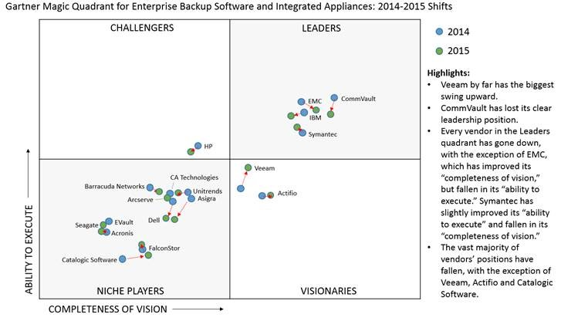
Az elmaradhatatlan... 2014-> 2015

Slide 9
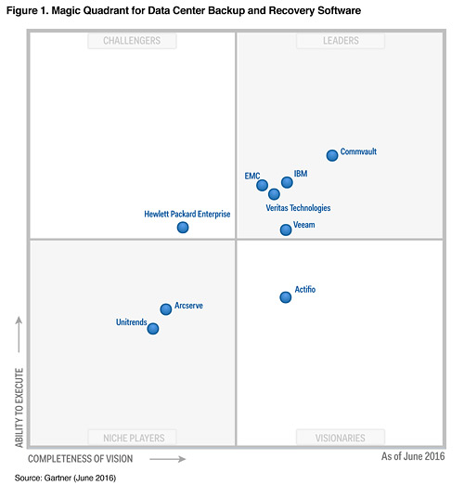
2016

Slide 10
Nyolc évnyi fejlesztés – első a piacon
v1
v3
v5
v6.1
v7
v9
2-in-1: backup
and replication
Instant File-Level Recovery
Built-in deduplication
Synthetic full backups
VM replication with multiple restore points
Instant File-Level
Recovery for Linux
ESXi support
without VCB
Instant VM Recovery
SureBackup
Universal Application Item Recovery (U-AIR)
On-Demand Sandbox
Instant indexing
VeeamZIP
Instant VM Recovery for Hyper-V
Veeam Backup
Free Edition
Built-in WAN Acceleration
Backup directly from Storage Snapshots
Veeam Explorer for Microsoft SharePoint
Virtual Lab for Replicas
Virtual Lab for Hyper-V
Scale-out Backup Repository
BitLooker
Veeam Explorer
for Oracle
On-Demand Sandbox for Storage Snapshots
Veeam Cloud Connect Replication
Q3 08
Q4 09
Q4 11
Q4 12
Q4 14
Q1 08
Q1 09
Q4 10
Q2 12
Q3 13
Q4 15
v2
v4
v6
v6.5
v8
Advanced VSS
integration
ESXi support
vStorage APIs (VADP)
Support for Changed Block Tracking
Support for thin-
provisioned disks
Replication
to ESXi
Intelligent load balancing
Hyper-V Changed Block Tracking
1-Click File Restore
Advanced replication
Veeam Explorer
for Storage Snapshots
Veeam Explorer
for Microsoft Exchange
ReFS support
Advanced backup monitoring, reporting and capacity planning
Backup I/O control
Snapshot Hunter
Password loss protection for encryption
Veeam Cloud Connect
Veeam Explorer
for SQL Server
Veeam Explorer
for Active Directory
Notes:
As you can see here, Veeam has spent the last 8 years on game-changing innovation, starting with our v1 release back in 2008, when we brought 2-in-1 backup & replication, and instant file-level recovery to virtual server backup for the first time
By the time we got to v5, it was clear we were revolutionizing the industry with cutting edge features like Instant VM Recovery, and SureBackup, which took advantage of the virtual infrastructure to bring about features that were either impossible or very expensive with physical servers and the legacy backup products of the day.
More recently, we’ve recognized the trend toward cloud – and toward IT as a service -- and brought forth technologies like Veeam Cloud Connect to help customers more easily back up their data offsite through service providers rather than taking on large IT investments themselves.
And with our announcement today, we’re ready to shake up the industry once again.

Slide 11
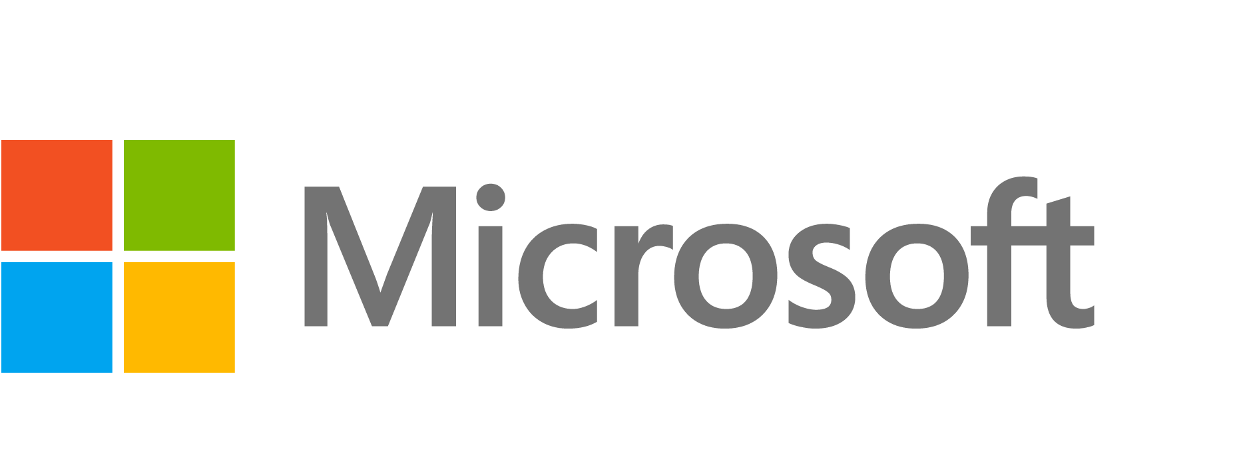









Veeam Availability Platform a Hybrid Cloud számára
Private Cloud /
On-Premises
Veeam
Cloud Connect
Veeam Availability Orchestrator
Disaster Recovery Orchestration for Enterprise
Veeam Availability Console
Veeam
Cloud Connect
Private Cloud & Virtual Workloads
Public Cloud & Physical Workloads
Veeam
Cloud Connect
Veeam Availability Suite
Veeam Agent
for Microsoft Windows
Veeam Agent
for Linux
Veeam Cloud
& Service Providers
(VCSPs)
Managed Cloud
Public Cloud
Compute
Storage
Networking
Hyperconverged
Notes:
Introducing the Veeam Availability Platform for the Hybrid Cloud
You can see here all the components that I was just discussing, bringing about the Next Generation of Availability for virtual, physical, and cloud-based workloads – across the hybrid cloud -- to enable the Always-On Enterprise
With this platform, Veeam will deliver enterprise continuity through our award winning virtual server technology, now with the addition of public cloud and physical server workload availability – and with the new Veeam Availability Console which brings these offerings, via cloud connect, to the private, managed, and public cloud.
In fact, Veeam Cloud Connect now serves as the underpinning technology that takes backups or replicas to the cloud, and that moves data between clouds, allowing you to achieve workload mobility.
And finally DR orchestration thru Veeam Availability Orchestrator, which not only aids in enterprise continuity, but also provides automatic DR plan documentation, for compliance, and visibility.
We’ll dig into these platform components a bit more later, but let me tell you a little more about our capabilities I just mentioned, listed at the bottom here.

Slide 12






Availability 24.7.365
Minden alkalmazás és adat számára
15 perces SLA – RPO, RTO
Üzemeltetési költségek csökkentése, átlátható licencelés, kiváló skálázhatóság
Notes:
John –
Our version 9.5 coming in October…
Delivers the scalability your business demands – whether it’s for thousands of VMs or millions of files - and the performance you need and cannot get from legacy backup vendors. To meet the demands of your Always-On Enterprise we:
Ensure Availability for ALL your apps and data, anywhere – on premises, or in the clouds
Exceeding your SLAs and cutting downtime – as you heard from the IDC report earlier Veeam enables businesses to reduce SLAs and to actually meet those SLAs. In 9.5 this gets even better with additional storage integrations and new backup and restore technologies
And, by optimizing your investment in IT spend – with FULL integration with Windows Server 2016, vCloud director enhancements, and more
Jeff – can you tell us more about the new 9.5 features that deliver improved scalability and performance?

Slide 13
Veeam Availability Platform for the Hybrid Cloud
Private Cloud /
On-Premises
Veeam
Cloud Connect
Veeam Availability Orchestrator
Disaster Recovery Orchestration for Enterprise
Veeam Availability Console
Veeam
Cloud Connect
Private Cloud & Virtual Workloads
Public Cloud & Physical Workloads
Veeam
Cloud Connect
Veeam Availability Suite
Veeam Agent
for Microsoft Windows
Veeam Agent
for Linux
Veeam Cloud
& Service Providers
(VCSPs)
Managed Cloud
Public Cloud
Compute
Storage
Networking
Hyperconverged
Notes:
Introducing the Veeam Availability Platform for the Hybrid Cloud
You can see here all the components that I was just discussing, bringing about the Next Generation of Availability for virtual, physical, and cloud-based workloads – across the hybrid cloud -- to enable the Always-On Enterprise
With this platform, Veeam will deliver enterprise continuity through our award winning virtual server technology, now with the addition of public cloud and physical server workload availability – and with the new Veeam Availability Console which brings these offerings, via cloud connect, to the private, managed, and public cloud.
In fact, Veeam Cloud Connect now serves as the underpinning technology that takes backups or replicas to the cloud, and that moves data between clouds, allowing you to achieve workload mobility.
And finally DR orchestration thru Veeam Availability Orchestrator, which not only aids in enterprise continuity, but also provides automatic DR plan documentation, for compliance, and visibility.
We’ll dig into these platform components a bit more later, but let me tell you a little more about our capabilities I just mentioned, listed at the bottom here.

Slide 14

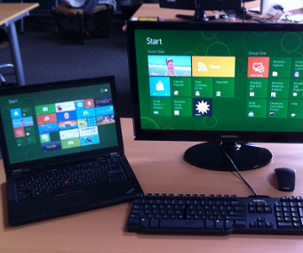




Minden fizikai szerver menthető
Végpontok, Szerverek:
Debian, Red Hat diszribuciók
Windows 7+, Windows 2008 Server +
Alkalmazás konzisztens
Blokk szintű mentés
Átlátható licencelés
Könnyű, központi adminisztráció
Notes:
John –
Why, physical workloads, and why now?
Well, on Average, nearly 80% of business workloads are virtualized. However due to hardware configurations and regulatory compliance requirements, some physical workloads cannot be virtualized. Yet, these workloads have the same Availability requirements.
And Enterprises can’t rely on legacy backup to recover what they need when they need it.
-Veeam Agents for Windows and Linux help you reduce downtime and data loss
-Further workload mobility between on-premises and public clouds.
-And removes the need for multiple backup solutions to protect physical machines, virtual machines, and public cloud-based workloads. Now, they can all be protected with Veeam.
Jeff – can you tell us more about the new Veeam Agents?

Slide 15
Veeam Availability Platform for the Hybrid Cloud
Private Cloud /
On-Premises
Veeam
Cloud Connect
Veeam Availability Orchestrator
Disaster Recovery Orchestration for Enterprise
Veeam Availability Console
Veeam
Cloud Connect
Private Cloud & Virtual Workloads
Public Cloud & Physical Workloads
Veeam
Cloud Connect
Veeam Availability Suite
Veeam Agent
for Microsoft Windows
Veeam Agent
for Linux
Veeam Cloud
& Service Providers
(VCSPs)
Managed Cloud
Public Cloud
Compute
Storage
Networking
Hyperconverged
Notes:
Introducing the Veeam Availability Platform for the Hybrid Cloud
You can see here all the components that I was just discussing, bringing about the Next Generation of Availability for virtual, physical, and cloud-based workloads – across the hybrid cloud -- to enable the Always-On Enterprise
With this platform, Veeam will deliver enterprise continuity through our award winning virtual server technology, now with the addition of public cloud and physical server workload availability – and with the new Veeam Availability Console which brings these offerings, via cloud connect, to the private, managed, and public cloud.
In fact, Veeam Cloud Connect now serves as the underpinning technology that takes backups or replicas to the cloud, and that moves data between clouds, allowing you to achieve workload mobility.
And finally DR orchestration thru Veeam Availability Orchestrator, which not only aids in enterprise continuity, but also provides automatic DR plan documentation, for compliance, and visibility.
We’ll dig into these platform components a bit more later, but let me tell you a little more about our capabilities I just mentioned, listed at the bottom here.

Slide 16




Veeam Availability Orchestrator
Tervek indítása
Replikák
Éles környezet
Disaster Recovery
FELÉPíTÉS
TESZTELÉS
DOKUMENTÁLÁS
Több site-os DR tervek, szerep delegálás, dinamikus kezelés
Automatikus terv teszt, alkalmazás tesztelés, részletes riporting
Template alapú DR Dokumentálás, automatikusan frissül
Notes:
Jeff
Sure – the key to how VAO can help you is in this 3-step description which I’ll share with you here.
First, VAO lets you build flexible, cross-site workflows that orchestrate Veeam replicas to perform failover plans
Next, you get automated, on-demand testing of these failover plans to confirm the location of replicas and the functionality of applications
And third, you get automatically maintained DR documentation to ensure up-to-date DR plans

Slide 17
Veeam Availability Platform for the Hybrid Cloud
Private Cloud /
On-Premises
Veeam
Cloud Connect
Veeam Availability Orchestrator
Disaster Recovery Orchestration for Enterprise
Veeam Availability Console
Veeam
Cloud Connect
Private Cloud & Virtual Workloads
Public Cloud & Physical Workloads
Veeam
Cloud Connect
Veeam Availability Suite
Veeam Agent
for Microsoft Windows
Veeam Agent
for Linux
Veeam Cloud
& Service Providers
(VCSPs)
Managed Cloud
Public Cloud
Compute
Storage
Networking
Hyperconverged
Notes:
Introducing the Veeam Availability Platform for the Hybrid Cloud
You can see here all the components that I was just discussing, bringing about the Next Generation of Availability for virtual, physical, and cloud-based workloads – across the hybrid cloud -- to enable the Always-On Enterprise
With this platform, Veeam will deliver enterprise continuity through our award winning virtual server technology, now with the addition of public cloud and physical server workload availability – and with the new Veeam Availability Console which brings these offerings, via cloud connect, to the private, managed, and public cloud.
In fact, Veeam Cloud Connect now serves as the underpinning technology that takes backups or replicas to the cloud, and that moves data between clouds, allowing you to achieve workload mobility.
And finally DR orchestration thru Veeam Availability Orchestrator, which not only aids in enterprise continuity, but also provides automatic DR plan documentation, for compliance, and visibility.
We’ll dig into these platform components a bit more later, but let me tell you a little more about our capabilities I just mentioned, listed at the bottom here.

Slide 18
A 3-2-1 –es szabály
3
2
1
Távoli telephelyen
található
Különböző médián
Különböző példány
cloud
SSL tunnel, SSL certificate (nem titkosításra használja)
Notes:
John
Because analyst data shows that less than 40% of businesses store data offsite- and thus don’t follow the 3-2-1 best practice for data availability – putting their data at risk.
The 3-2-1 rule states that you need to keep three copies of your data, stored on two types of media (disk and tape for example), and with one copy being off site in case of disaster strikes your data center.
But, getting backups off site can be challenging due to limited bandwidth, exploding amounts of data and a lack of resources required to build and maintain a true offsite backup repository.

Slide 19
Veeam Availability Platform for the Hybrid Cloud
Private Cloud /
On-Premises
Veeam
Cloud Connect
Veeam Availability Orchestrator
Disaster Recovery Orchestration for Enterprise
Veeam Availability Console
Veeam
Cloud Connect
Private Cloud & Virtual Workloads
Public Cloud & Physical Workloads
Veeam
Cloud Connect
Veeam Availability Suite
Veeam Agent
for Microsoft Windows
Veeam Agent
for Linux
Veeam Cloud
& Service Providers
(VCSPs)
Managed Cloud
Public Cloud
Compute
Storage
Networking
Hyperconverged
Notes:
Introducing the Veeam Availability Platform for the Hybrid Cloud
You can see here all the components that I was just discussing, bringing about the Next Generation of Availability for virtual, physical, and cloud-based workloads – across the hybrid cloud -- to enable the Always-On Enterprise
With this platform, Veeam will deliver enterprise continuity through our award winning virtual server technology, now with the addition of public cloud and physical server workload availability – and with the new Veeam Availability Console which brings these offerings, via cloud connect, to the private, managed, and public cloud.
In fact, Veeam Cloud Connect now serves as the underpinning technology that takes backups or replicas to the cloud, and that moves data between clouds, allowing you to achieve workload mobility.
And finally DR orchestration thru Veeam Availability Orchestrator, which not only aids in enterprise continuity, but also provides automatic DR plan documentation, for compliance, and visibility.
We’ll dig into these platform components a bit more later, but let me tell you a little more about our capabilities I just mentioned, listed at the bottom here.

Slide 20







Veeam Availability Console
A szolgáltatók és a több telephelyen működő nagyvállalatok sok hasonló kihívással találkoznak
Szolgáltató
Nagyvállalat
Tenant vagy leányvállalat kezelés
Távoli mentés és replikáció
kezelés
Felügyelet/
jelentéskészítés
Showback/
Chargeback
Veeam Availability Console
Notes:
Jeff
So John mentioned how this new product helps both service providers and enterprises manage either their customers or their remote offices.
This is the case because service providers and distributed enterprises share many similar challenges that impact management costs.
They both need to manage tenants, or departments; they both deal with remote backup & replica management
They also require monitoring and alerting – as well as showback in the case of enterprises or chargeback & billing in the case of service providers
Veeam Availability Console addresses these challenges by including functionality to make all of these tasks easier…

Slide 21
Köszönöm a figyelmet
Matyas Keszler| Territory Manager Hungary | Veeam Software |
Mobile: +36 20 333 5153
Address: Switzerland, Linden Park, Lindenstr. 16 / CH 6340 – Baar
E-mail: matyas.keszler@veeam.com www.veeam.com

